Slide 1

Build it and they will come!

Slide 2

Introductions:
Ms. Cynthia Herrera – Law/Government Academy Coordinator
Ms. Christine Van Allen- Crime Scene photo
Mrs. Carolyn Lundie- Forensic Science
Ms. Billie Baumgartner- English /Law
Mr. Mark Burstein- Math/Law
Mr. Kevin Tait- Industry member

Slide 3
What is our Academy all about?
The Highland High School Law & Government Academy is one of the career-path programs
We provide students with a preview of careers in the legal profession, law enforcement or related government service
This program operates on the Highland High School campus, but students come from all over the Antelope Valley
The Academy offers a combination of academic preparation and job-related experiences
Highland has formed a partnership with the community through a Law & Government Academy Advisory Committee focusing on work-based training
The Academy’s ultimate goal is to expose students to multiple job and career opportunities in all related disciplines of law and government service
Our efforts provide a better foundation for college, or post-secondary training jobs within the career pathway of law and government

Slide 4
What is in our Curriculum?
Students in the Law & Government Academy program exceed the requirements for high school graduation.
Academy classes have integrated law and government lesson plans into academic core and elective classes. Most of our elective classes are A-G.
Learning is fun! There are “real life” applications in all of our courses.
The purpose of the program is to expose students to the possible careers in the field, so that they can make good choices for the future. At the same time, students complete all of the necessary pre-requisites for education and training after high school.
Those students who successfully complete 50 credit hours of selected coursework in the Academy and complete 150 service learning hours, will earn a special notation on their high school transcripts and graduate them with a white embroidered stole to wear at graduation.
Students may participate in field trips and Career Day to give them a first-hand look at the various occupations. Additionally, students have the opportunity to engage in workplace job shadowing and job-site visitations or internships..

Slide 5
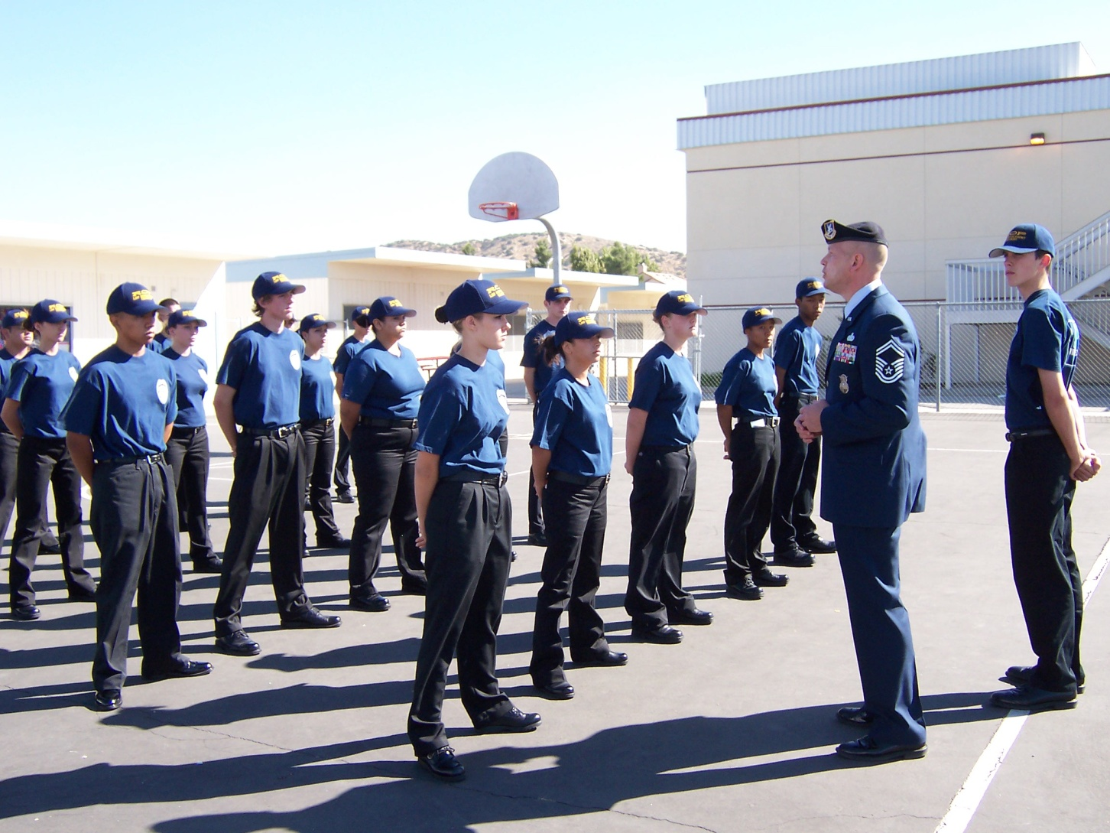
ROP Law and Order and Public Policy class.

Slide 6

Law Enf. Class/ Demo

Slide 7
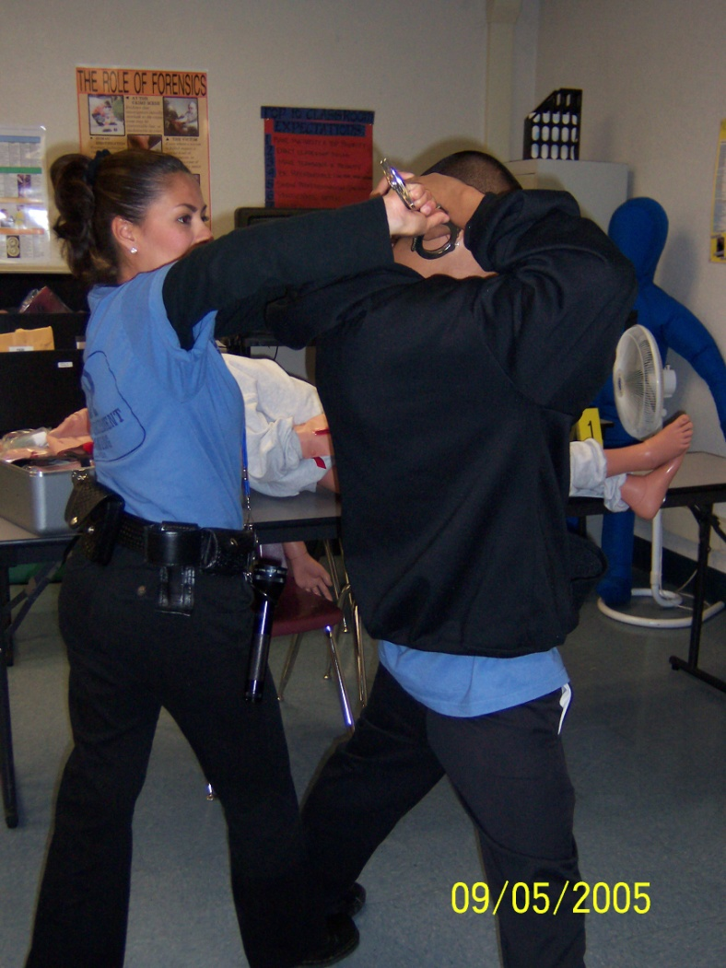
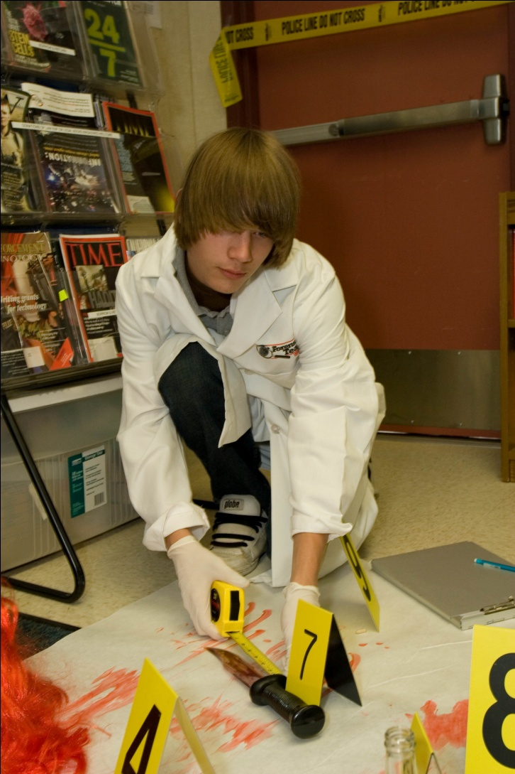
My 3 core classes (a-g)college articulated

Slide 8
What does the Academy do for the (you) Student?
Students are placed in A-G classes AND earn DUAL high school and college credit! W@W!!
Increase your academic skills and broaden your options for the future
Grant you a certificate of completion in a specialized program
Give you recognition on your high school transcript
Place you in classes with students who have similar interests and goals
Allow you the opportunity to take field trips to law and/or government work sites
Provide you with the opportunity to gain valuable work experience by performing an internship while still in high school
Expose you to speakers with expertise in different areas of law and government
Offer you the opportunity to survey the jobs available and the many career options within the career pathway of law and government and related occupations
Give you the experience necessary to succeed in a job
Allow you the ability to perform in Mock Trial competitions

Slide 9


Slide 10
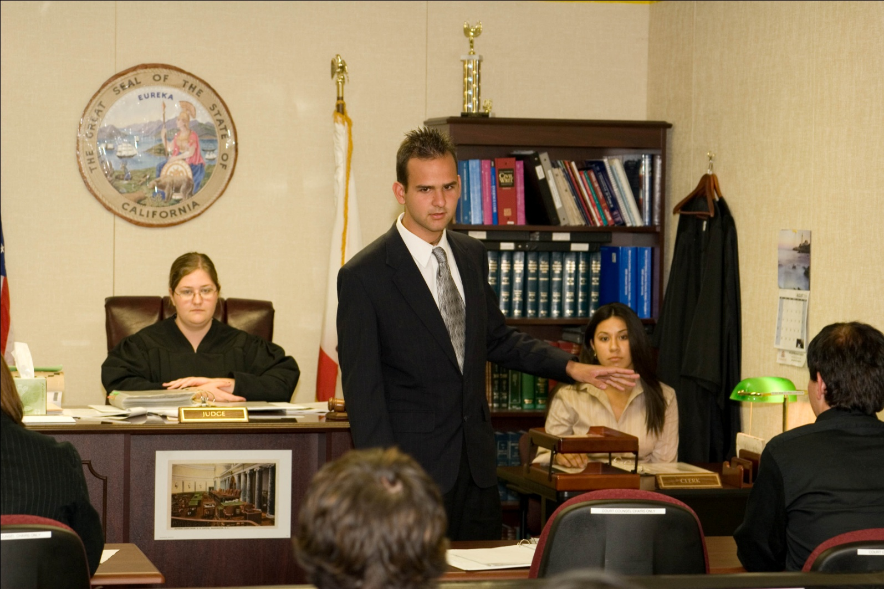
Learning now, earning later.
Notes:
Time to solicit

Slide 11
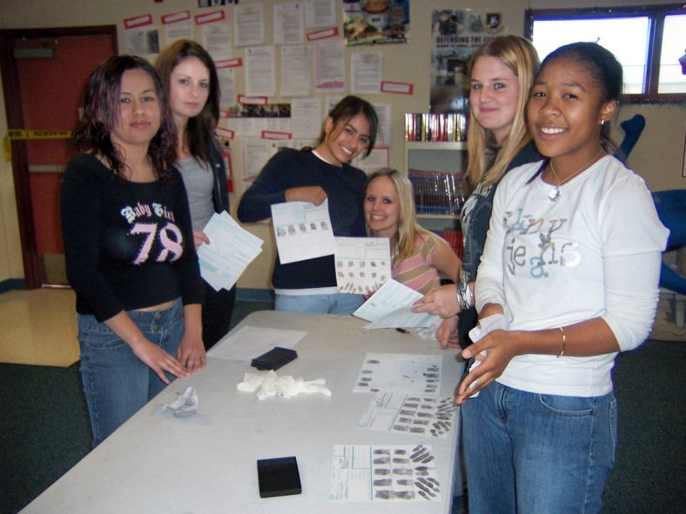
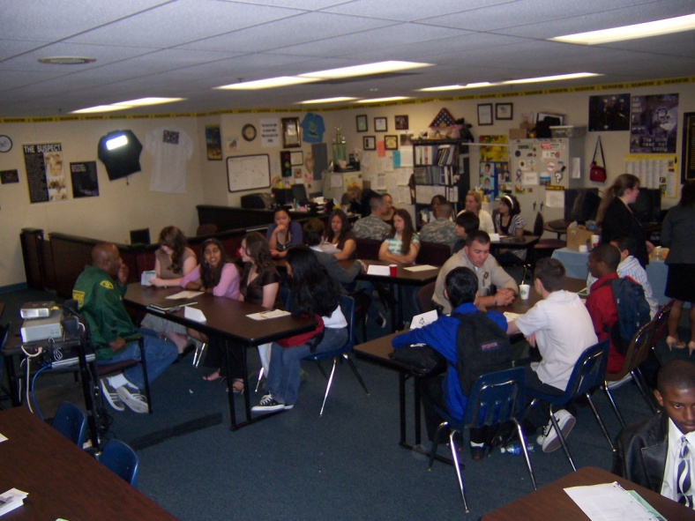
Training to Networking:
Hands on Training
Career Day with Industry Professionals.

Slide 12
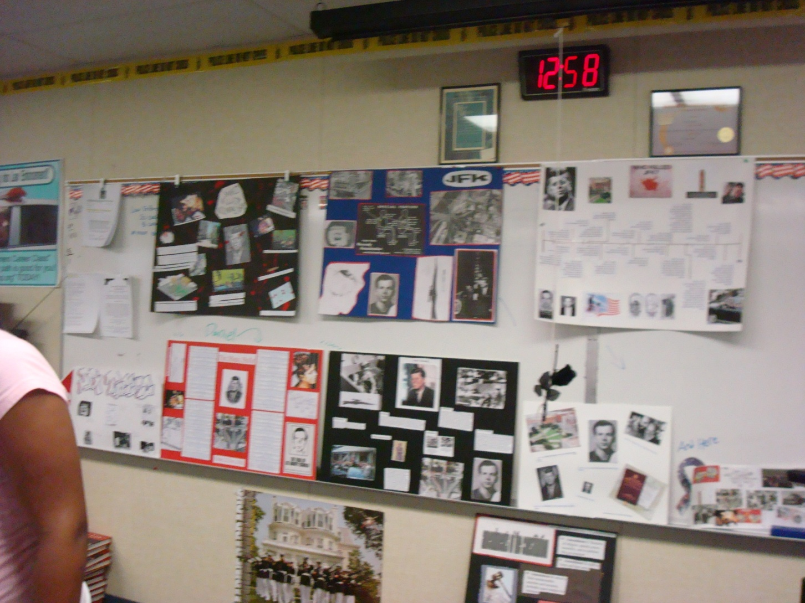
Portfolios

Slide 13
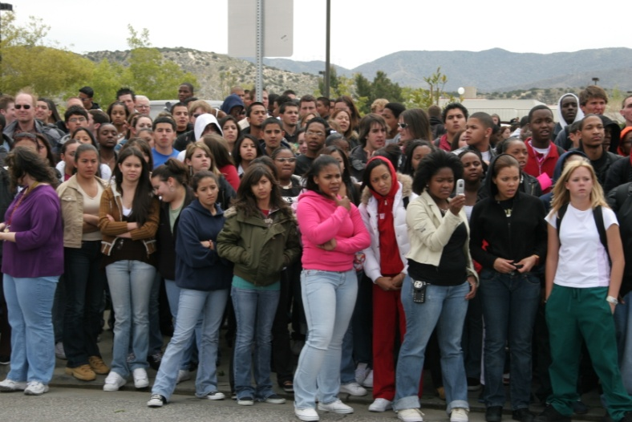
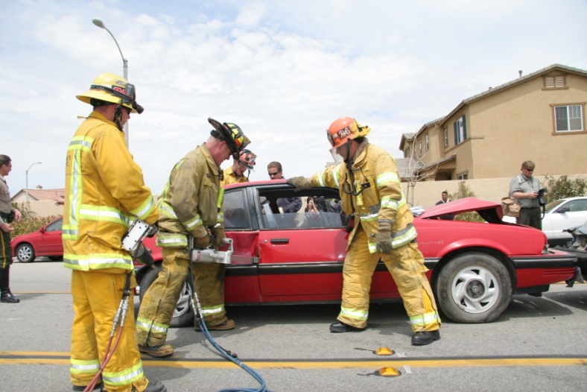
Academy Projects:
“Every 15 minutes”

Slide 14
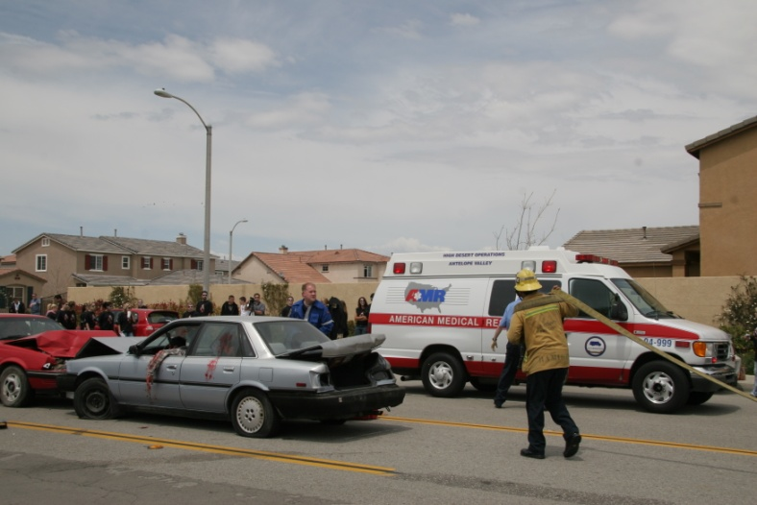
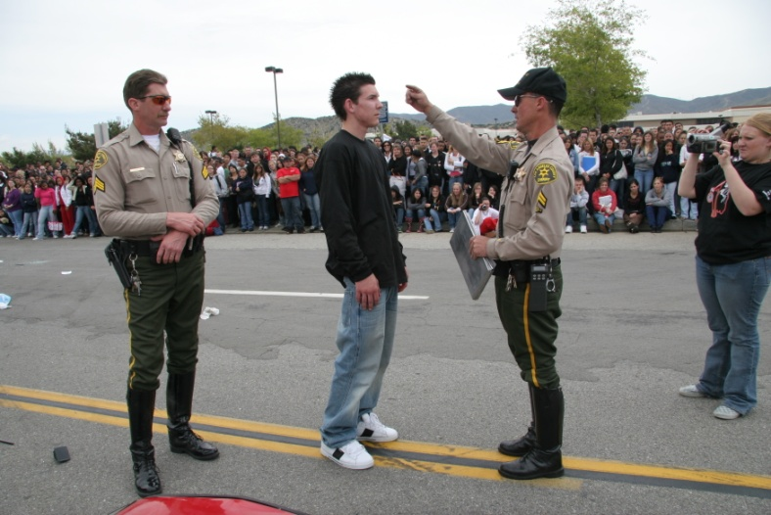
Cont.

Slide 15
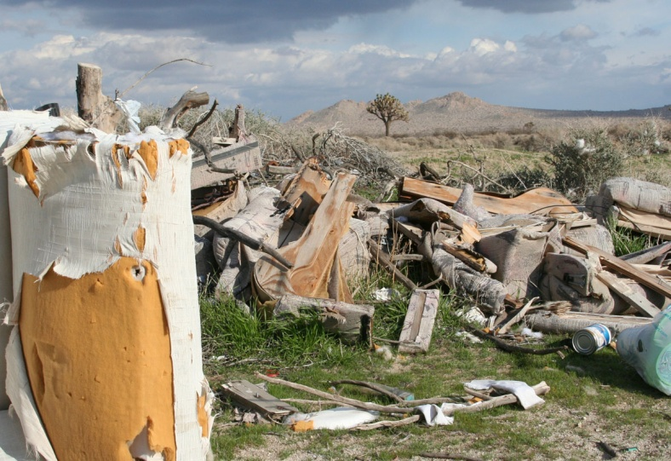
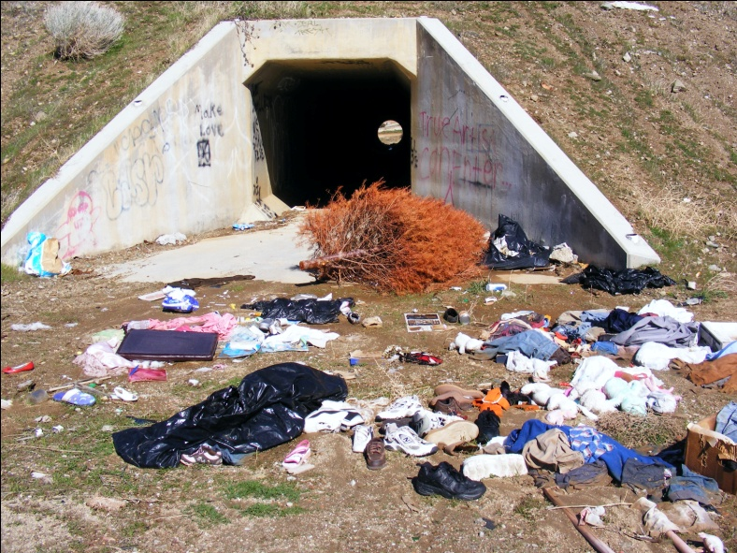
A.V.I.D.T.F
(Antelope Valley Illegal Dumping Task Force)

Slide 16
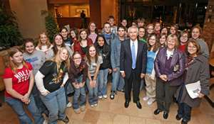
Community
Legacy Project (F-101 Voodoo)
Teen Help Line
Canned Food Drive
Decorating Doors
Packages for Soldiers
Toys for Tots

Slide 17
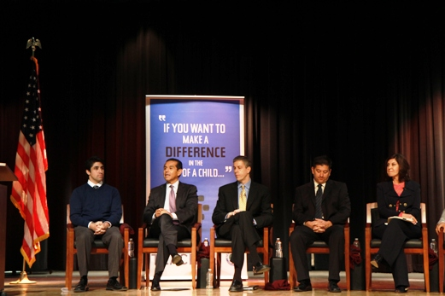
Guest Speakers
Los Angeles Mayor Villaraigosa recognition
Probation and Parole Officers
Deputy Sheriffs and Private Investigators
Industry Professionals
Service Recruiters
City of Palmdale
Mayor R. Rex Parris

Slide 18

Success Stories..Where are they now?

Slide 19
Studies Show…
Males make up 69% of all U.S. patrol officers, while females make up 31%. 55% are Caucasian, 28% are African-American, and 11% are Latino-American. All other groups comprise 6% of highway patrol officers in the U.S.
www.educationportal.com

Slide 20
2016
2006
2016
Increase from 2006 to 2016 reference from www.bls.gov indicates lawyers will increase 84,000 people and police officers 70,000.

Slide 21

Welcome to Highland High School
Law and Government Academy
39055 25th st. West
Palmdale CA 93551
cherrera@avhsd.org
(661) 538-0304 xt. 521

